Slide 1
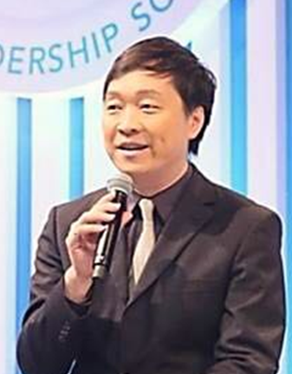
超連鎖事業的初衷
The Why
Marcus Tai
顧問經理級
Supervising Coordinator
四個佣金週期共賺取HK$57,500
HK$57,500 in 4 Commission weeks
本簡報中提到的收入等級純屬舉例說明，無意代表美安香港超連鎖™店主的一般收入，也無意表示任何超連鎖™店主皆可賺取同等收入。美安香港超連鎖™店主的成功與否，取決於其在發展事業時的努力、才能與投入程度。
The income levels mentioned in the following presentation are for illustration purposes only. They are not intended to represent the income of a typical Market Hong Kong UnFranchise ™Owner, nor are they intended to represent that any given Independent UnFranchise ™ Owner will earn income in that amount. The success of any Market Hong Kong Independent UnFranchise ™ Owner will depend upon the amount of hard work, talent, and dedication which he or she devotes to building his or her Market Hong Kong Business.

Slide 2
顧問
57500

Slide 3
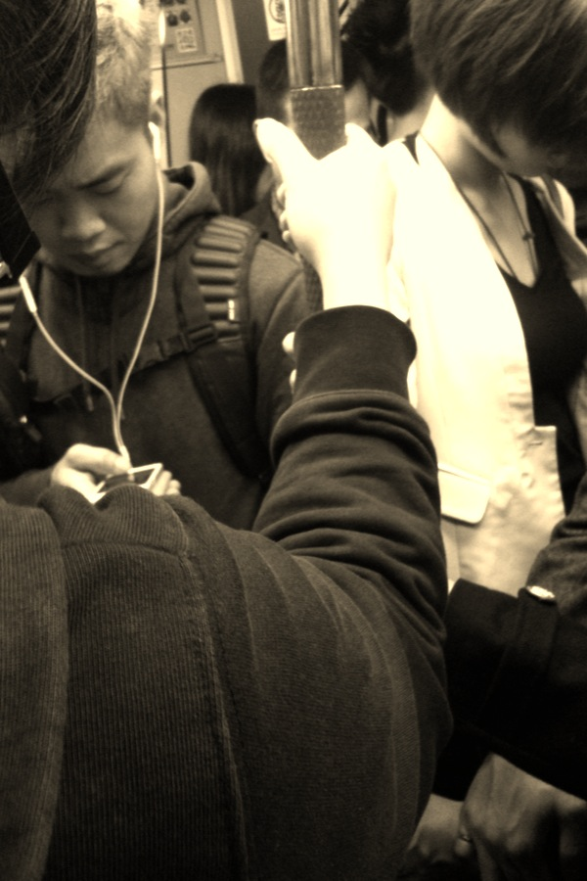
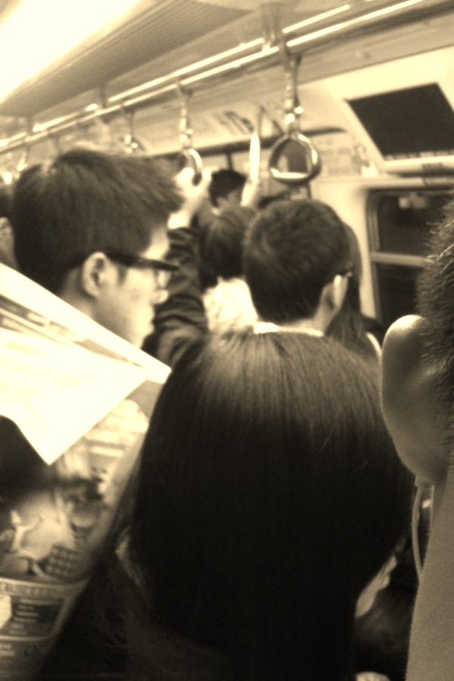
等
等放工、等週未、等放假、等退休
等轉好工、等揾到好老公
等成功、等發達
等變得更好

Slide 4
為甚麼 ? WHY ?

Slide 5
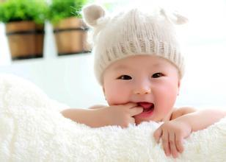

Slide 6
富爸爸，窮爸爸？
富小孩！

Slide 7
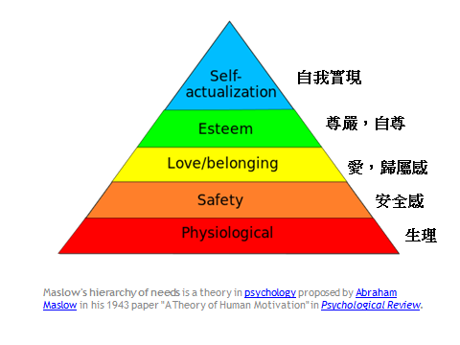

Slide 8
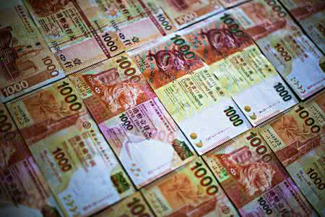

Slide 9
財商 Wealth Quotient

Slide 10
趨勢
世界已變成
THE WORLD HAS GONE
數碼化
創業的人數前所未有的多 - 出生於嬰兒潮（出生率急升的時期）的人尋找另一個事業機會 - 人們有更大自由，並有更多需要
地舖、樓上舖天價租金
中國的網購網站「淘寶網」，創下去年11月11日「光棍節」購
物折扣日營業額突破美金120億元
Notes:
Job security, make more money, five times the average worker, personal development to maximize your human potential. The dream – freedom. Seven thousands baby boomers a day turn 65. working from home creates an opportunity for Plan B.
You can make it happen. It is not easy. It takes effort. And, in a sick way...it feels like pleasure. You have a impact on the community and economic growth. And, you become part of the solution.

Slide 11
Notes:
JF will introduce SR

Slide 12
45年工作計劃 vs 2-3年計劃
工作 消費 賺錢
永續消費 vs 永續收入

Slide 13
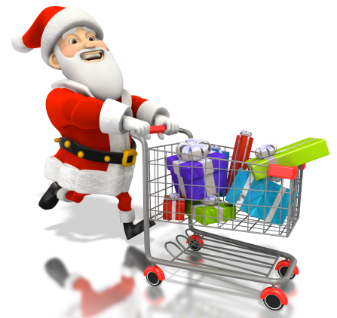
SHOP.COM
轉換支出成為收入
Converting Spending Into Earning
ma
cashback

Slide 14
顧問
57500

Slide 15
夢想，使命

Slide 16
當你擁有一個宏偉的夢想，
你就可以吸引無數個也有夢想的人，來一起努力，一起實現夢想。

Slide 17
這一切源於

Slide 18
重點在於
歸零學習，身到，心到

